Slide 1
Tutorial 2
Tips, tricks and practice
Edo Kiper
edo.kiper@weizmann.ac.il
Benozyo (biology) – Room 234
Office hours: 14-16, Monday, Benozyo (biology) – Room 234

Slide 2


The pseudo code
Any type of non-formal coding language
Used to set goals and overall structure for the code

Slide 3
7-BOOM
The rules:
Go over the numbers from 1 to N.
Replace every number that is divisible by 7
or contains the digit 7 with the word BOOM.
Play and print the game until the 100th term.
1 2 3 4 5 6
BOOM!

Slide 4
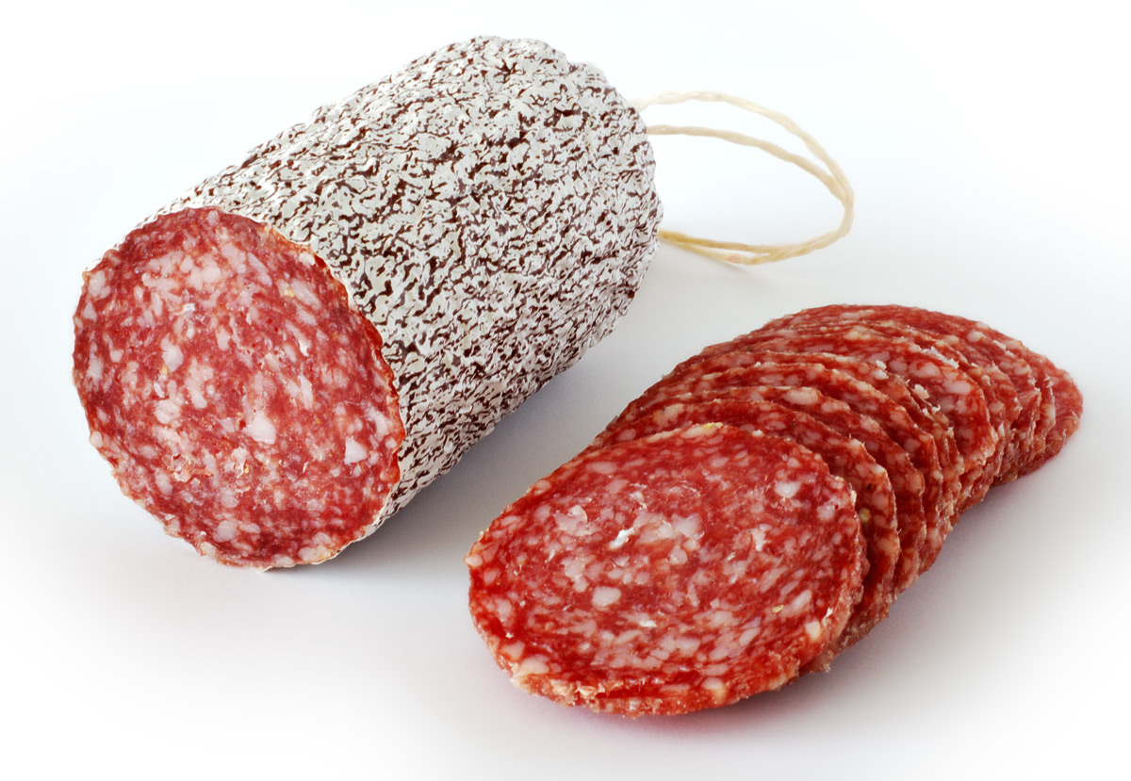
1. Break the instruction into little goals
Computers are stupid and not intuitive. You are smart and intuitive. Guide the computer to do your job with
the simplest instructions possible.
Big problem
Small problems

Slide 5
Questions/Human language:
Go over the numbers from 1 to N.
Pseudo code language:
Create a vector from 1 to N, increasing by 1 in each step

Slide 6
Questions/Human language:
1. Replace every number that is divisible by 7 or 2. contains the digit 7 with the word BOOM.
Pseudo code language:
Go over the terms in the vector and evaluate if they are divisible by 7.

Slide 7
Questions/Human language:
1. Replace every number that is divisible by 7 or 2. contains the digit 7 with the word BOOM.
Pseudo code language:
Go over the terms in the vector and evaluate if they contain the digit “7”.

Slide 8
Questions/Human language:
1. Replace every number that is divisible by 7 or 2. contains the digit 7 with the word BOOM.
Pseudo code language:
Based on the two conditions, evaluate for each term if at least one them is satisfied.

Slide 9
Questions/Human language:
1. Replace every number that is divisible by 7 or 2. contains the digit 7 with the word BOOM.
Pseudo code language:
Change the values that meet at least one of the conditions to the word BOOM

Slide 10

2. Go to your toolkit
Your toolkit is everything you learned in class and google and youtube.
Choose the tools you need to convert
Pseudo code to computer code

Slide 11

3. Convert Pseudo code to R code
Start simple, and progressively generalize your code. Test run it all the time
Small victories

Slide 12

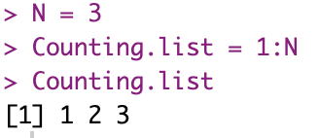
Pseudo code language:
Create a vector from 1 to N, increasing by 1 each step
Computer language:

Slide 13

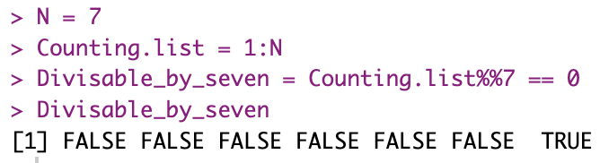
Pseudo code language:
Go over the terms in the vector and evaluate if they are divisible by 7.
Computer language:

Slide 14
Toolkit ALART!!
%% is the operator for modulo
sum(), sums all the values in a vector.
FALSE = 0, TRUE = 1
Q. How can we know how many TRUEs are in a vector?
Q. How can we know that there is at least one TRUE in a vector?
Q. How can we know that all values in a vector are TRUE?

Slide 15
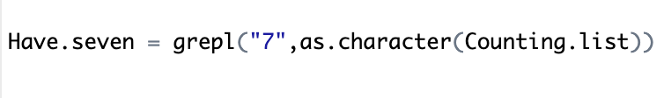
Pseudo code language:
Go over the terms in the vector and evaluate if they contain the digit “7”.
Computer language:

Slide 16
Toolkit ALART!!
grepl() return TRUE or FALSE if a character pattern
is found/not found within a string.
as.____() change the type of an object to a different
to a different type.
as.character(123) -> “123”
as.numeric(“123”) -> 123

Slide 17
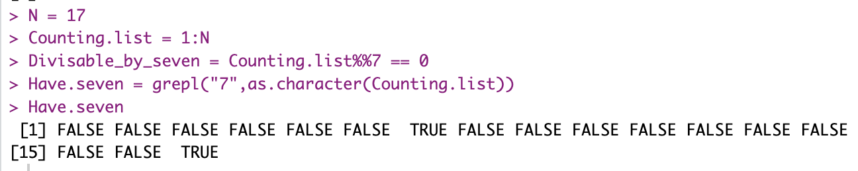
Pseudo code language:
Go over the terms in the vector and evaluate if they contain the digit “7”.
Computer language:

Slide 18
Pseudo code language:
Based on the two conditions, evaluate for each term if at least one them is satisfied.
Computer language:

Slide 19
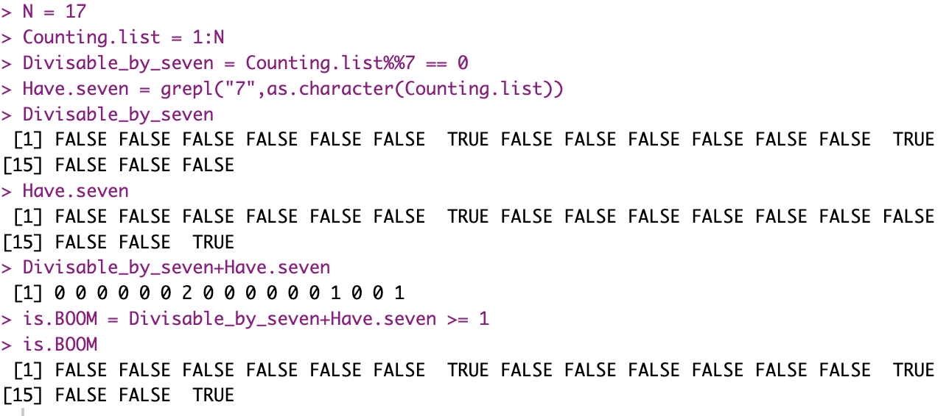

Slide 20
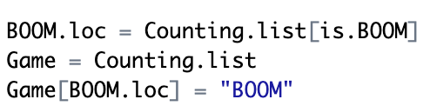
Pseudo code language:
Change the values that meet at least one of the conditions to the word BOOM
Computer language:

Slide 21
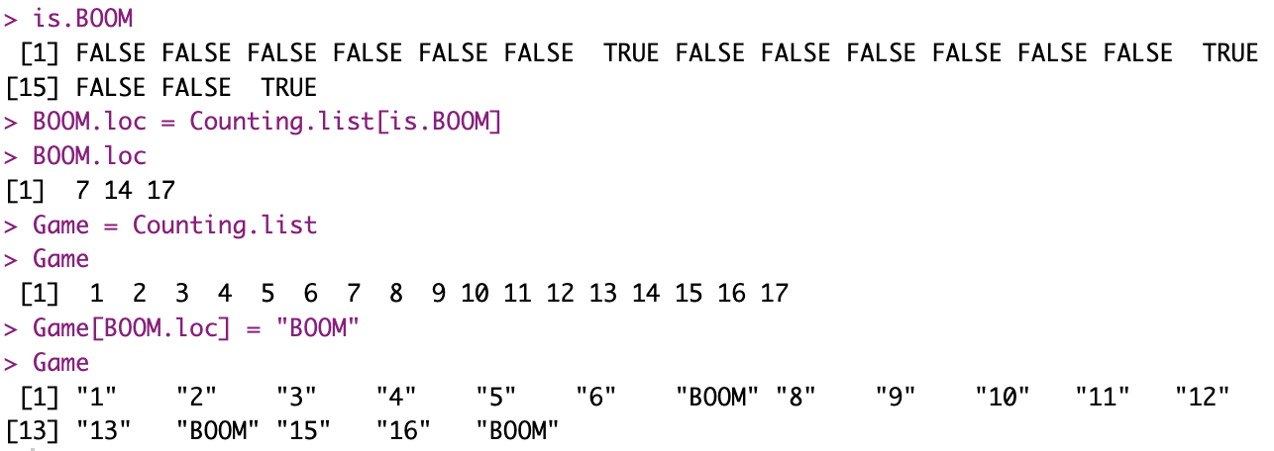

Slide 22
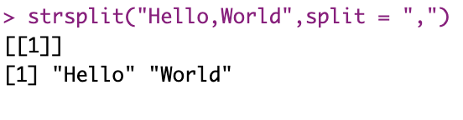
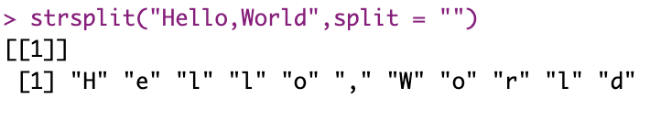
Toolkit ALART!!
strsplit() break a string into a vector based on a
user provided symbol. The function return a list
names() assigns a name to each element in a
vector. can help in retriving values based on chr
values.

Slide 23
Toolkit Reminder!
list() can save multiple objects of different kinds.
Student.data = list(Names = c(“Dan”,”Sharon”), Grades = c(80,100))
[[1]] syntax to access list index.
[[“Grades”]] Index can be named
unlist() open the list in the most ”logical” way
[[1]]
[[2]]

Slide 24
Binary to Decimal
Index:
3
2
1
0
1 0 0 1
2³ 2² 2¹ 2⁰
Coeff:
1x2³ 0x2² 0x2¹ 1x2⁰
Use?:
1x2³+0x2²+0x2¹+1x2⁰ = 9

Slide 25
Toolkit Reminder!
floor() rounds down a number
ceiling() rounds up a number
log()
abs() returns the absolute value
length() returns the number of values in a vector

Slide 26
DNA to RNA
A-T/U
G-C
DNA: AAATTGC…
RNA: UUUAACG…

Slide 27
Codons to Amino Acids
#1 aa
#2 aa
#3 aa
ATGCGGCTT…

Slide 28
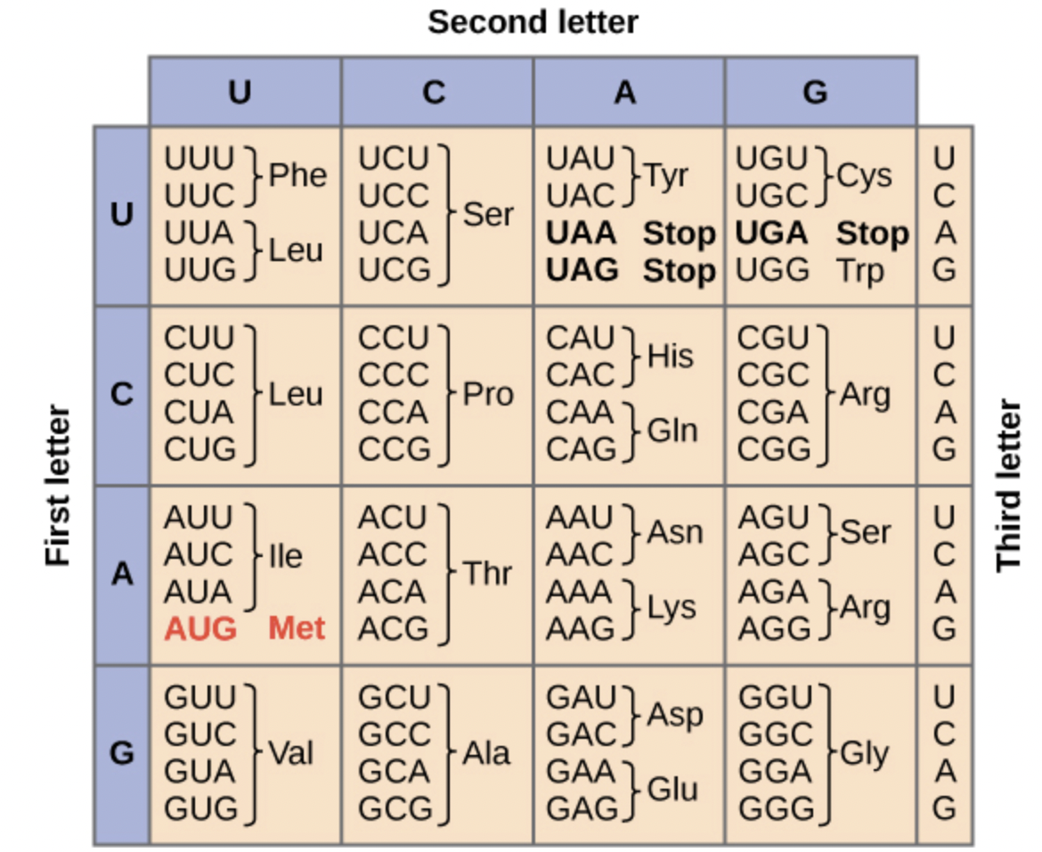

Slide 29
Toolkit Reminder!
readRDS() load a saved variable into R.
You need to store the loaded variable inside another
variable
Df = readRDS(“data_for_practice.Rds”)

